Slide 1





SUMOFlow AI: AI-Driven Traffic Optimization for Next-Generation
Smart Cities: A YOLO-SUMO Integration Approach
Team Members:
Supervisor:
Rana Waleed
Dr. Mohamed Maher
Roaa Raafat
Mariam Alhaj
Submission Date: 2025-11-22
CSAI School

Slide 2


The Problem Statement
Problem Statement:
Smart cities still rely on inefficient fixed-time traffic lights that do not adapt to real-time traffic.
Impact:
Traffic Congestion
Long waiting time
Higher CO₂ emissions
Fuel waste
Motivation
Smart cities are expanding, traffic is becoming unpredictable, and we need an AI-driven system that reacts instantly to reduce delays and emissions.

Slide 3


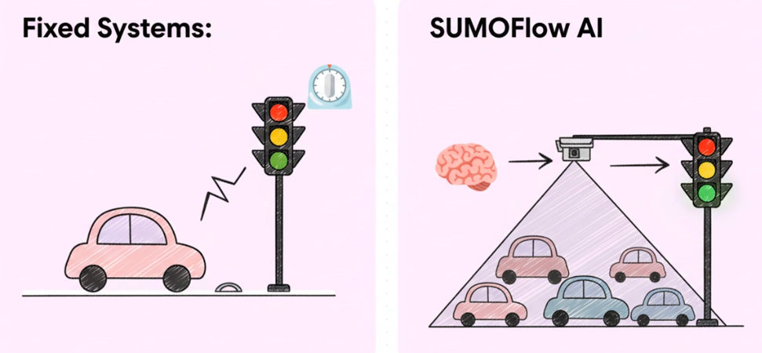
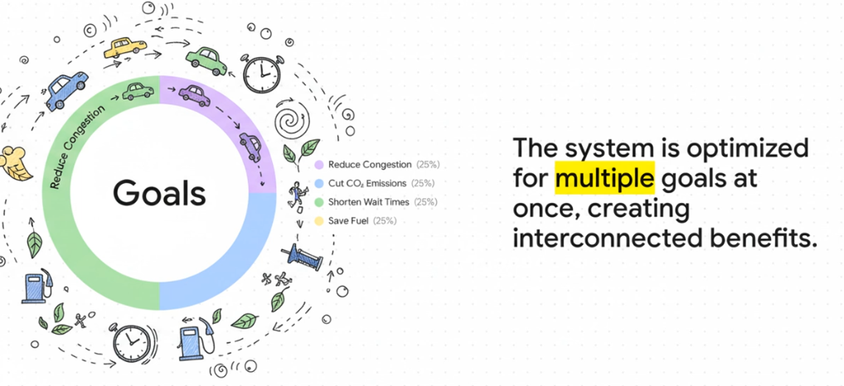
The Proposed Solution
Proposed Solution Overview
SUMOFlow AI integrates SUMO traffic simulation, YOLO object detection, and optimization algorithms to dynamically control traffic light timing and improve traffic flow.
Key Features
Traffic simulation for many scenarios using SUMO
Real-time vehicle detection using YOLO
Optimization engine to find best signal timings
Reduction of congestion and CO₂ emissions

Slide 4
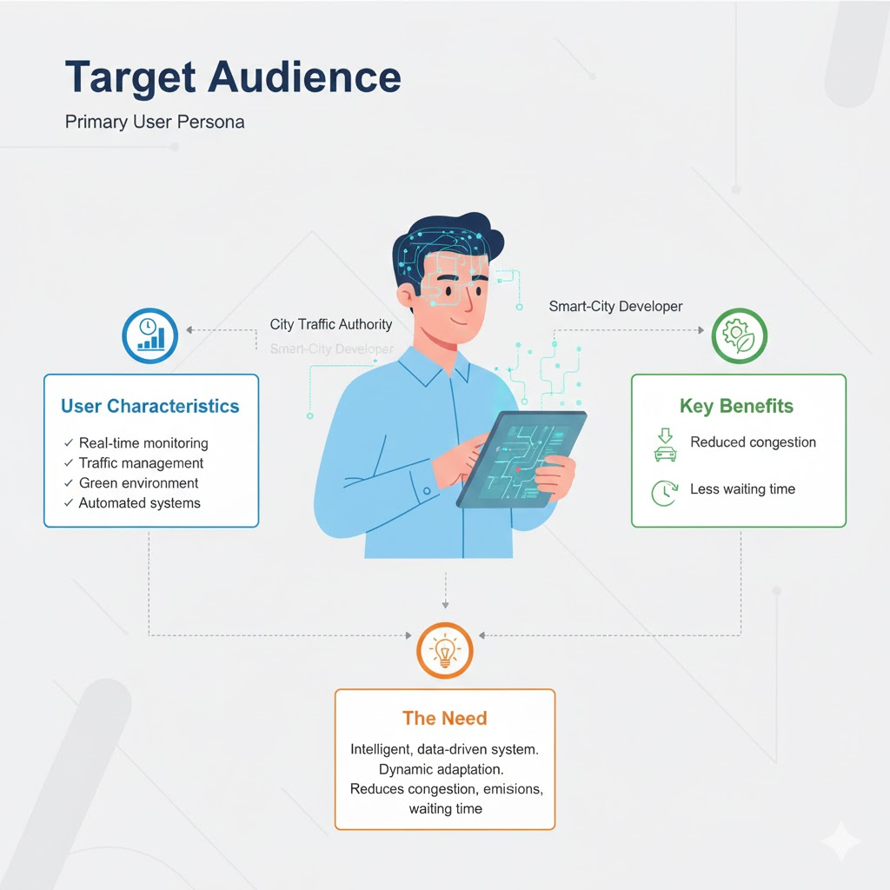
Target Audience
Primary User Persona
City traffic authorities, transportation departments, and smart-city developers.
User Characteristics
Need real-time monitoring
Manage traffic networks and congestion
Aim to improve environmental quality
Seek efficient and automated traffic systems
The Need
They require an intelligent, data-driven system that adapts signal timing dynamically to reduce congestion, emissions, and waiting time solving a gap current fixed-timing systems cannot.

Slide 5





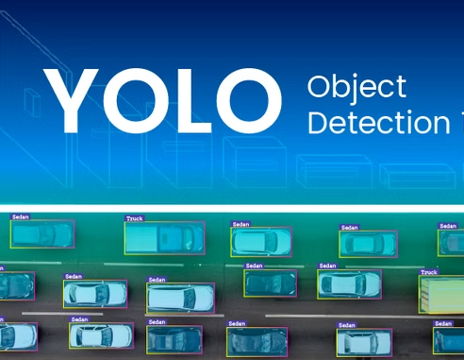
Competitive Analysis
Giza Systems ITS (NAC)
Dubai RTA – UTC-UX Fusion System (MENA / UAE)
Feature
SUMOFlow AI
Core Technology
SUMO, YOLO, Optimization
Big Data, Adaptive Algorithms
V2X, Predictive AI, Digital Twin
User Experience
Real-time, Simulation, Loop
Analytics, Signal Adaptation
Central Control, Coordination, Public Transport
Integration Capability
City Infrastructure, Sensors, Digital Twin
Simulation, Modular, Cameras
Unified ITS, Smart City Apps
Cost Structure
Low, Simulation, Incremental
High CAPEX, Maintenance
High Infrastructure, Operational Cost
Key Differentiators : What Makes SUMOFlow AI Significantly Different ?
Our Innovation
1 - Real-Time Video-Based Detection + High Granularity
2- Multi-Objective + Sustainability Focus (Emissions)
3- Tight Feedback Loop via Simulation
4- Low-Risk, Cost-Effective Prototyping
https://www.gizasystems.com/solutions/transportation/ https://gulfnews.com/uae/transport/dubai-rta-launches-next-generation-ai-powered-traffic-signal-system-1.500195097

Slide 6














Project Roadmap
Project Timeline
This section outlines the high-level plan for the remainder of the project, detailing key phases and milestones to guide development.
Current
Phase 2
Week 9
Development
Phase 1
Phase 3
Requirements and Design
Testing and Launch
Key Milestones
Week 10-12
Week 13-16
Week 17-18
SUMO network setup and YOLO detection.
YOLO integration , Optimization algorithm implementation.
Testing traffic scenarios , Performance evaluation and Final deployment preparation.

Slide 7





Q&A
Thank You & Questions?
Team Contact Information
s-rana.gindy@zewailcity.edu.eg
s-mariam.mahmoud@zewailcity.edu.eg
s-roaa.said@zewailcity.edu.eg
Email address
+201282852037
+20 11 17783891
+20 11 54003838
Phone Number
We welcome your feedback and insights
CSAI School | Zewail City of Science, Technology and Innovation

